Slide 1
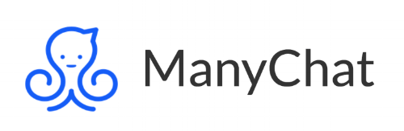
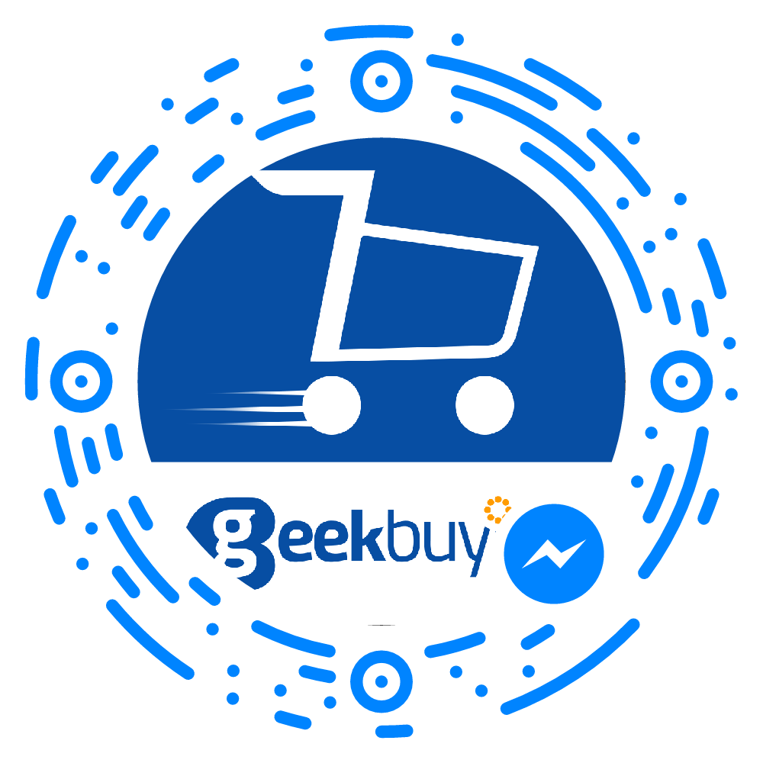
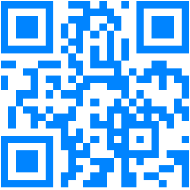
Flows, JSON Ad, Comment Growth tool

Slide 2
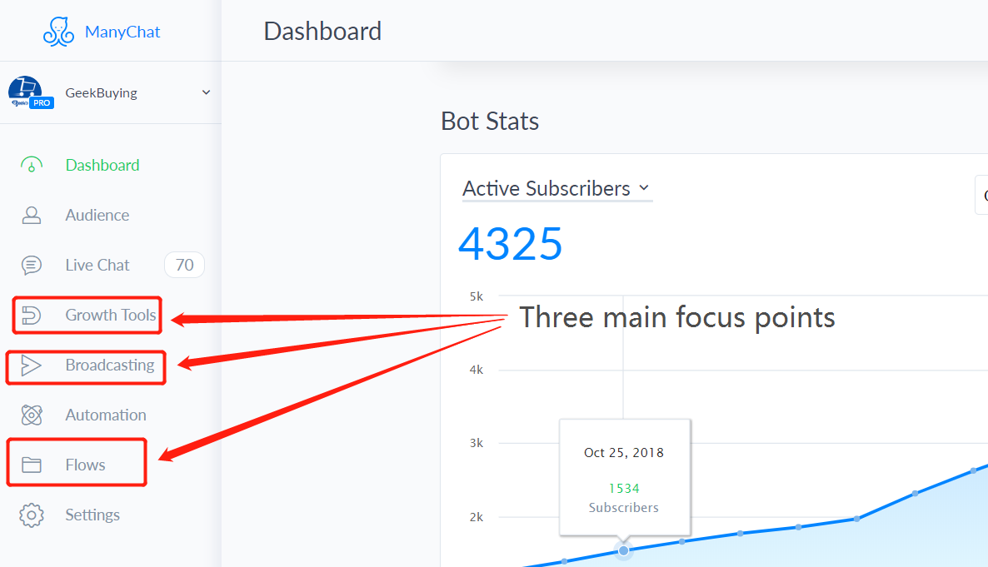

Slide 3
Growth Tools & Flows
Growth tools are a way to send your users to the Facebook Messenger.
Flows are a way to collected data, deliver a message, push a sale, or engage with a user in messenger.

Slide 4
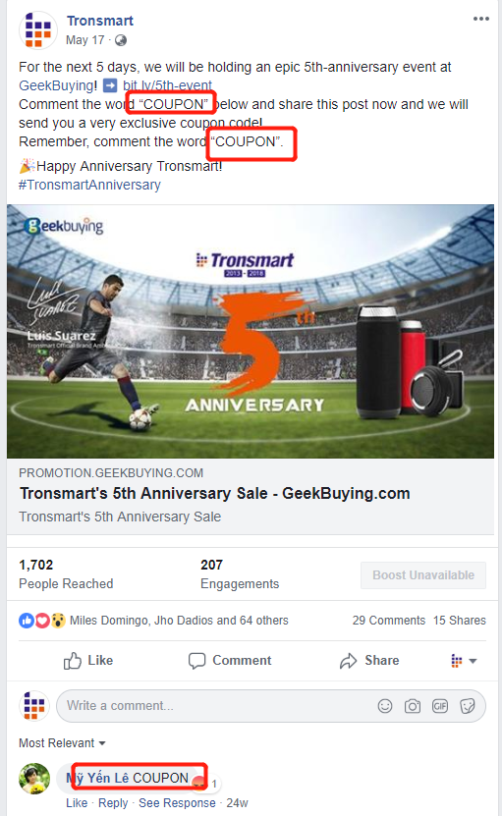
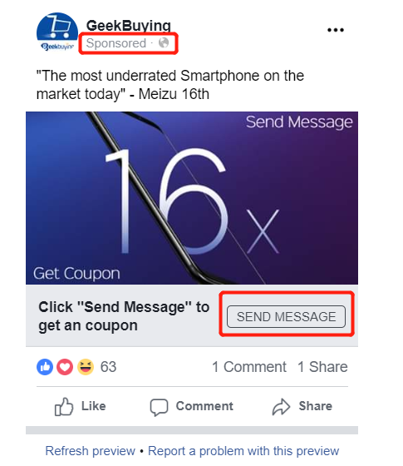


Growth Tool Examples

Slide 5
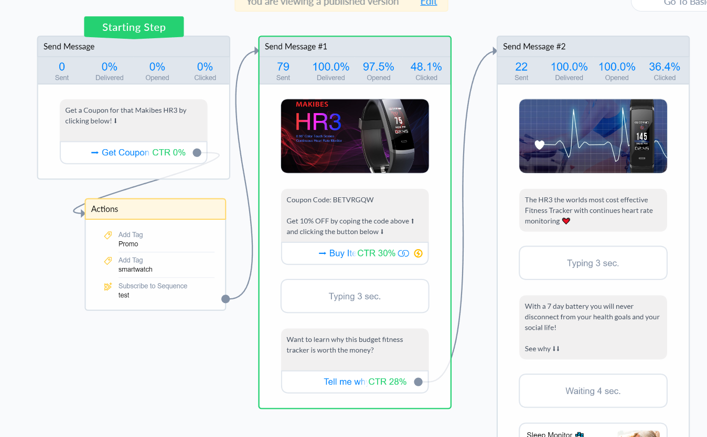
Flow Example

Slide 6
Creating a Flow:
The Tronsmart Trim
In this example we will create a flow that will be used for the comment growth tool and a JSON Ad. This flow will be created to accomplish four main objectives:
Collect user data for re-targeting
Deliver a coupon (reason to buy)
Provide a path to buy (link to site)
Give more info about the product
See flow: https://drive.google.com/file/d/1fN0BuNZdTI-wU5FaqkISIvGHW7z9EEOL/view?usp=sharing

Slide 7
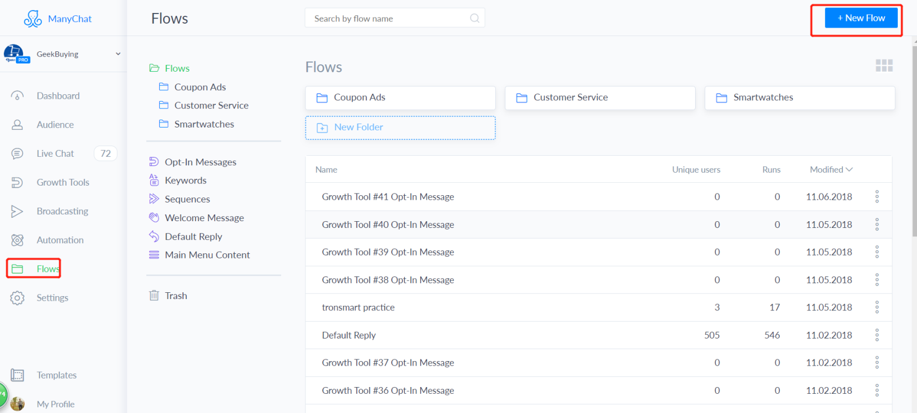
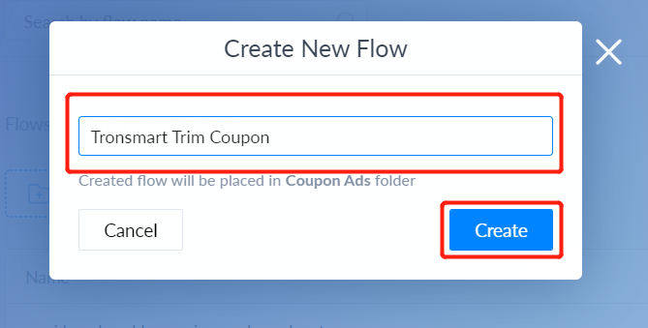
Step One: Open & Name

Slide 8
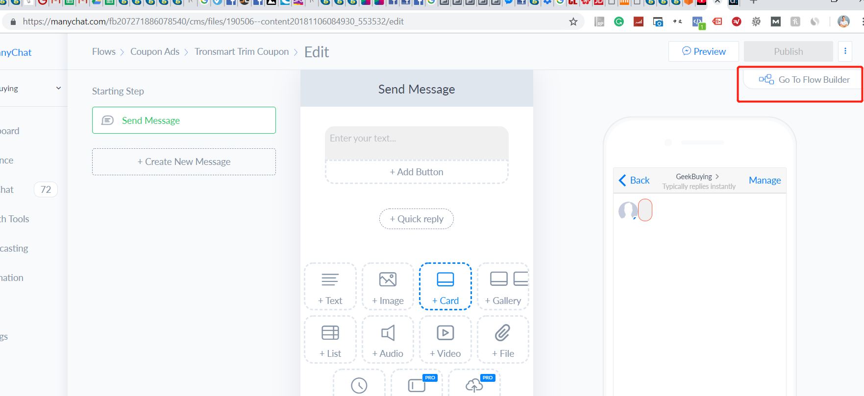
Step Two: Flow builder for advanced options

Slide 9
Step Three:
Create an “Opt-in” message
The “Opt-in message” is the first step of the flow. It is a message that explains what will happen in the flow.
The Opt-in message usually has a button taking the user to the next step of the flow, but it can also use an “input box” to take the user to the next step.
If you want a user to become a subscriber the user MUST engage with your Opt-in message.

Slide 10
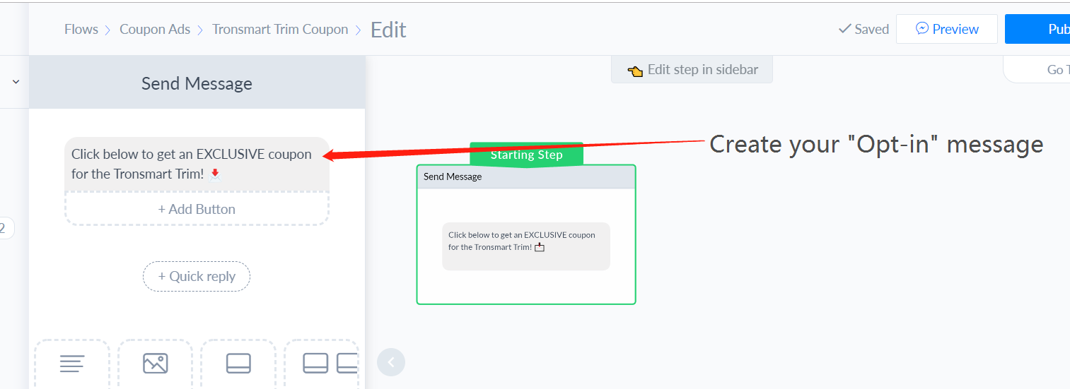
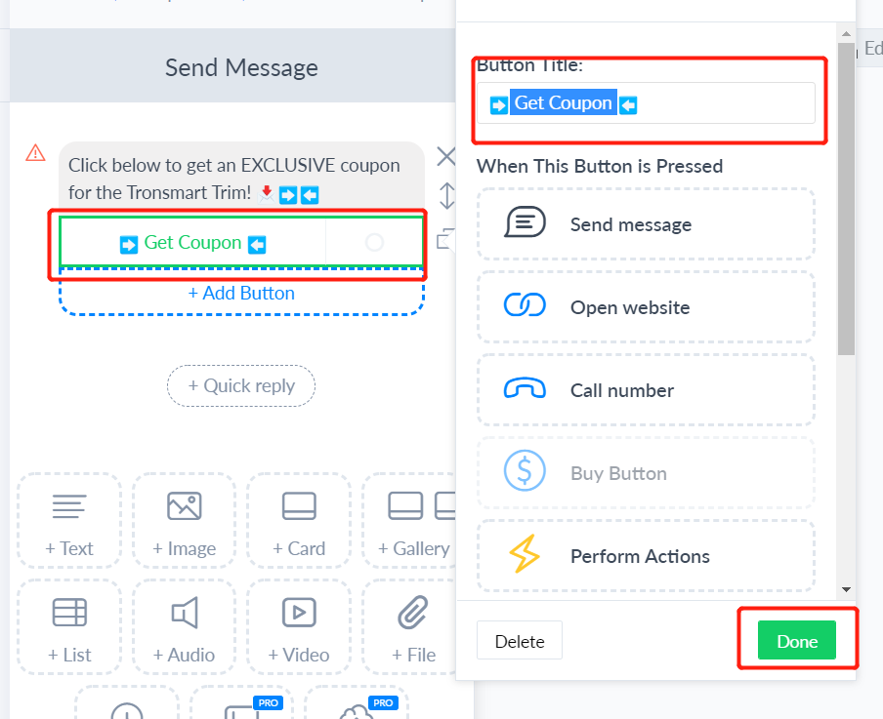
Opt-in Message
then create your button

Slide 11
Step Three: Add tags
Adding tags to specific steps of your flow will help you organize your audience for future targeting.

Slide 12
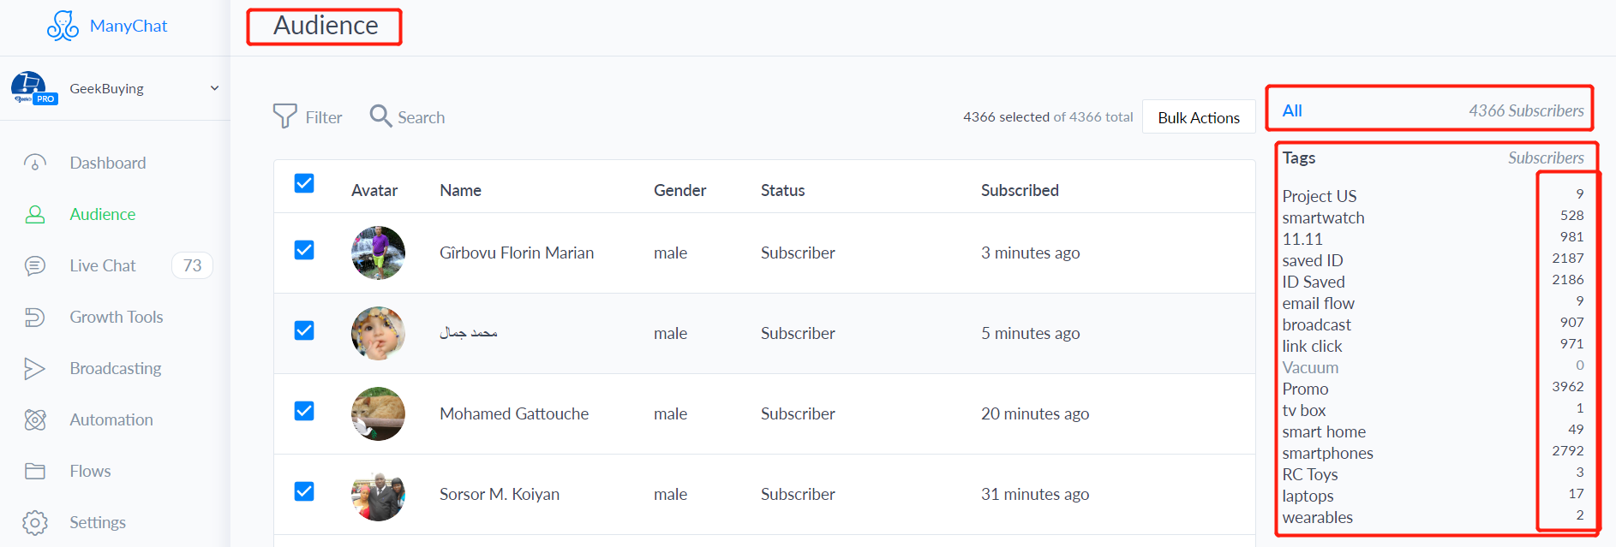
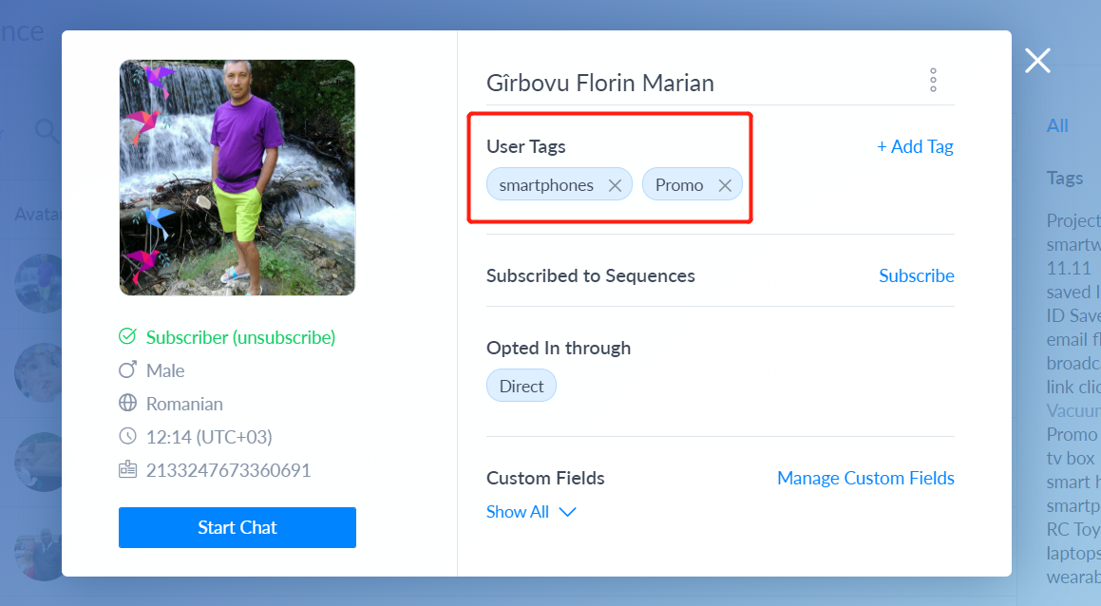

Slide 13
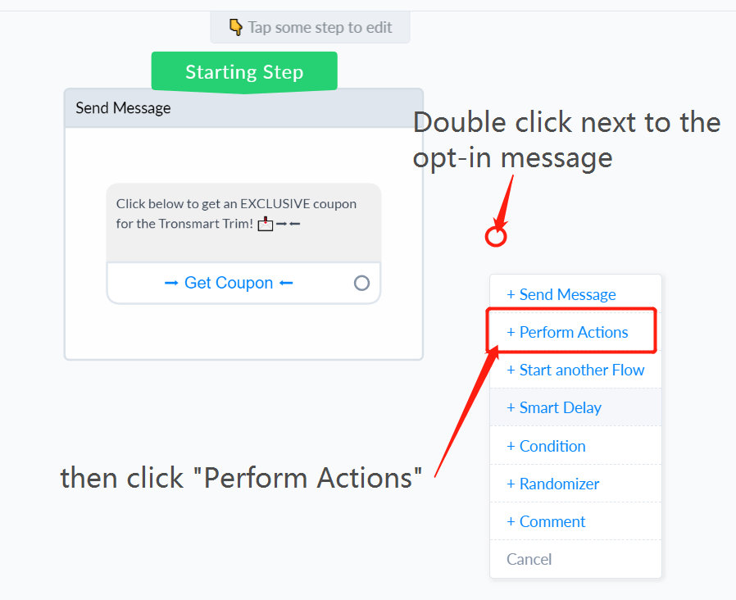
Adding a Tag

Slide 14
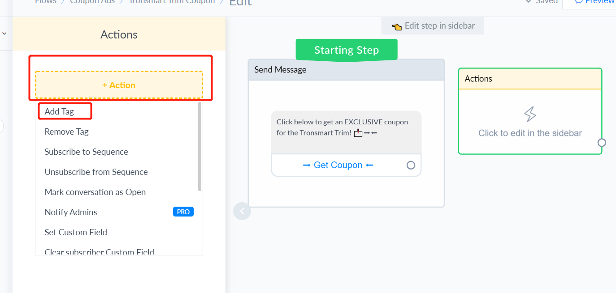

Slide 15
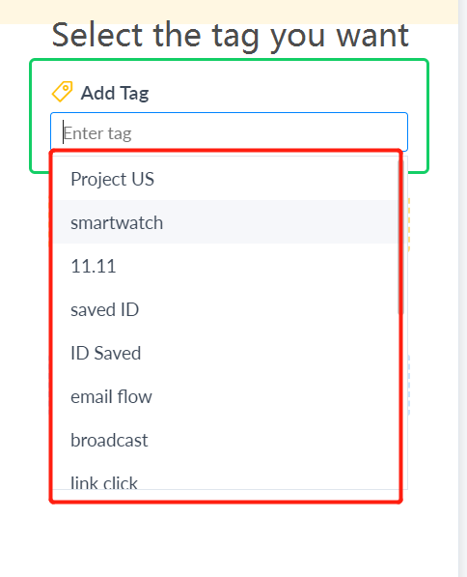
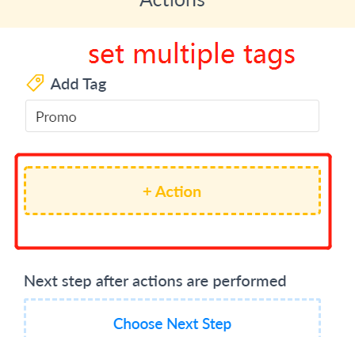
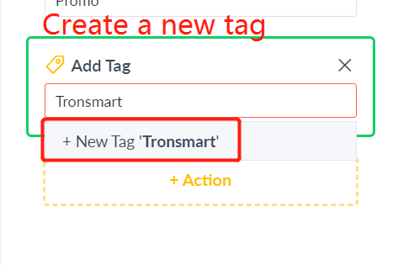

Slide 16
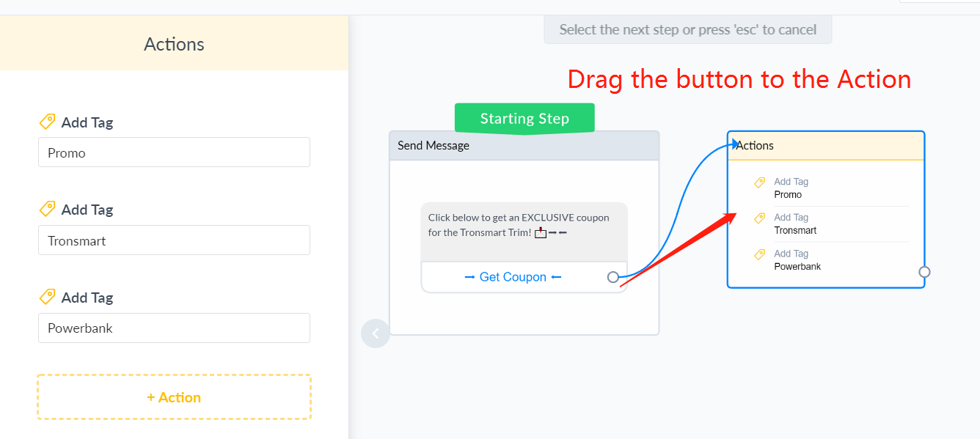

Slide 17
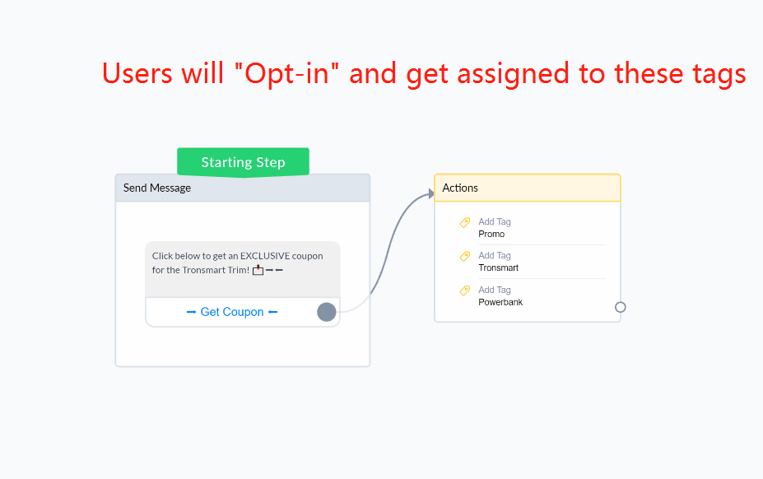

Slide 18
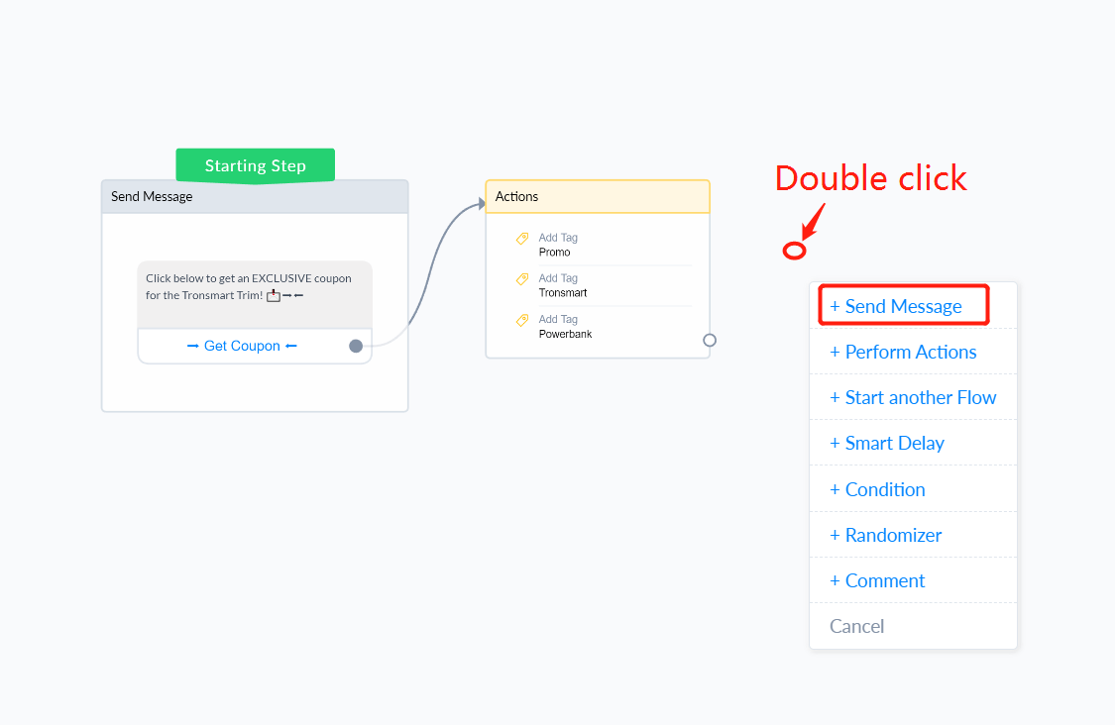
Step four: Finish the flow

Slide 19
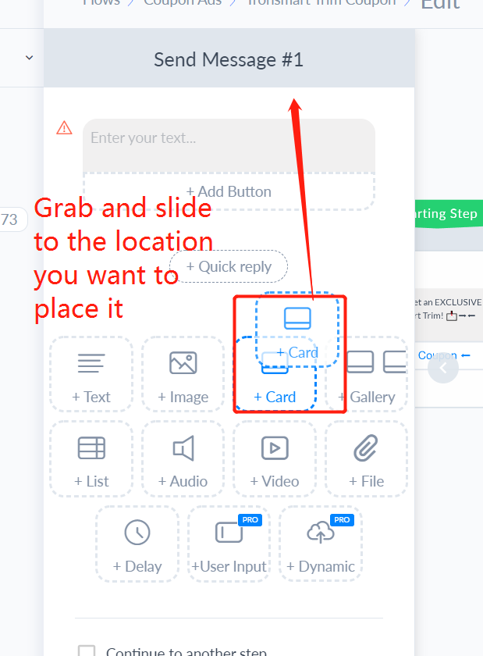
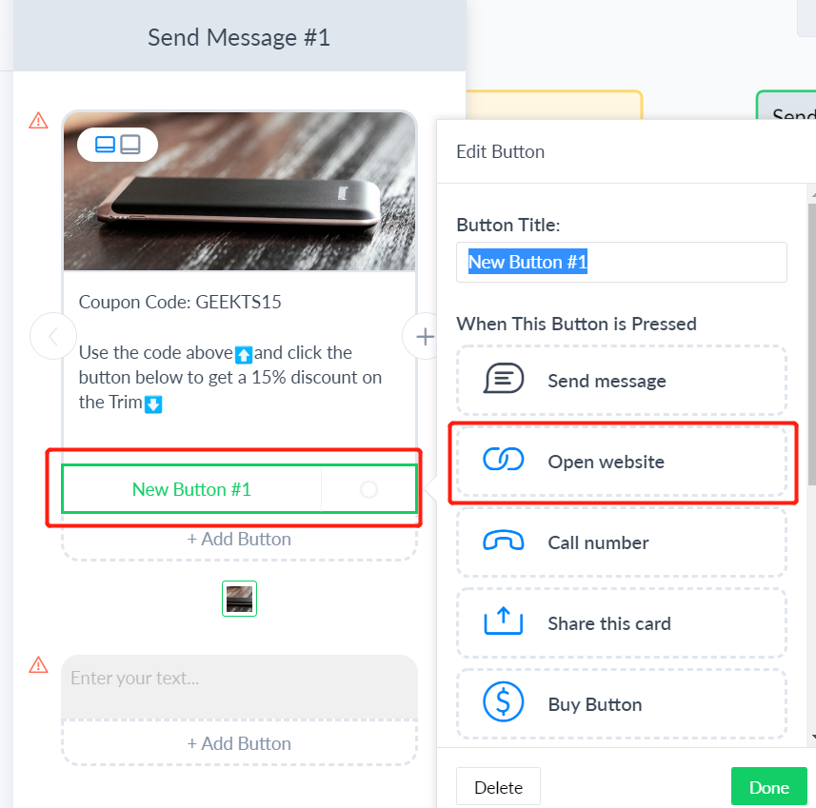
Finish the flow with whatever content you want to send
Add a button and make it a link to the product.

Slide 20
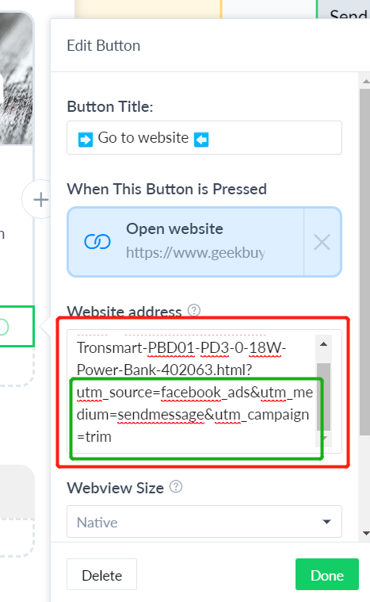
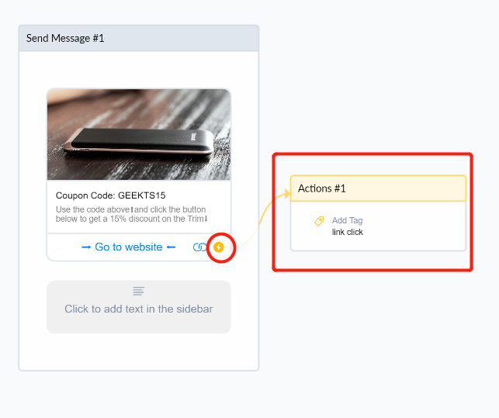
Enter the button name.
Add a tag to segment users that click links
Enter the link and don’t forget to add UTM parameters so you can track clicks.

Slide 21
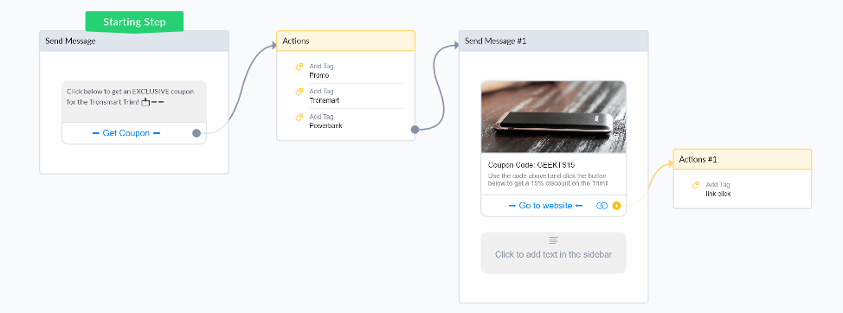
Basic Delivery Flow (Part 1)
1. Opt-in: Users click here and become “Subscribers” (we collect their data.)
3. Delivery: Subscribers receive the “message” (coupon)
2. Tag: Subscribers pass through the tags and become segmented into targetable categories.
4. Call-to-action: Subscribers can take action (buy through the link).

Slide 22
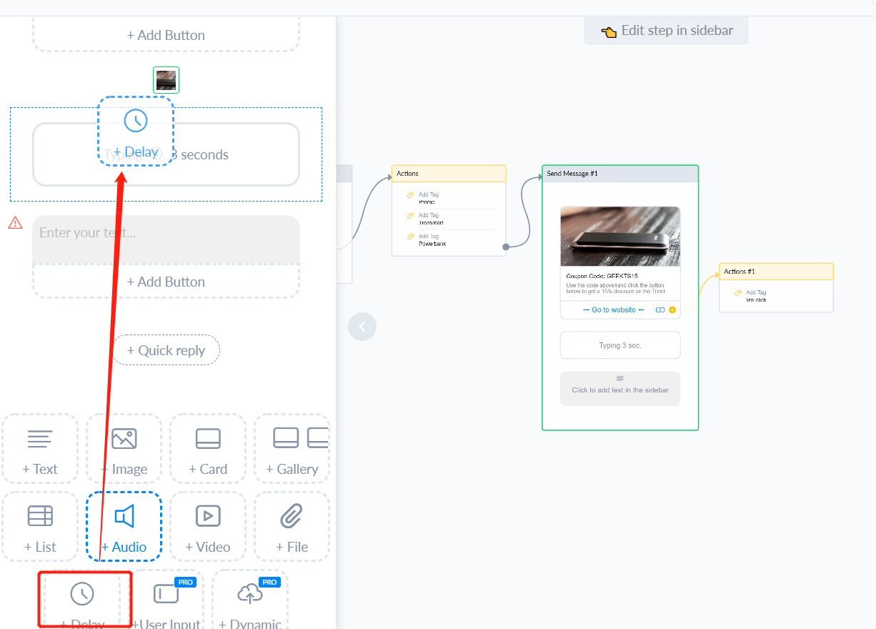
Extended Delivery Flow

Slide 23
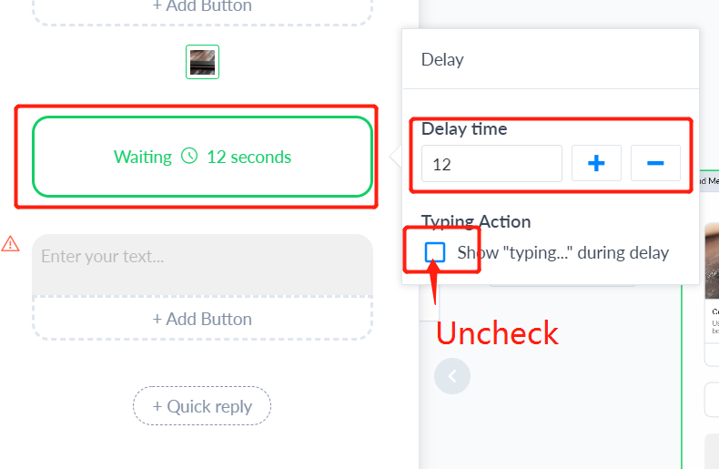
Adding a delay will help bring the user back if they have left. For example, if a user gets the coupon we still have not fully convinced him on why he should buy the product. If you add a 15 second delay that could bring the user back into messenger to learn even more about your product. You can extend the flow to talk about why the product is good. This will help increase conversions.

Slide 24
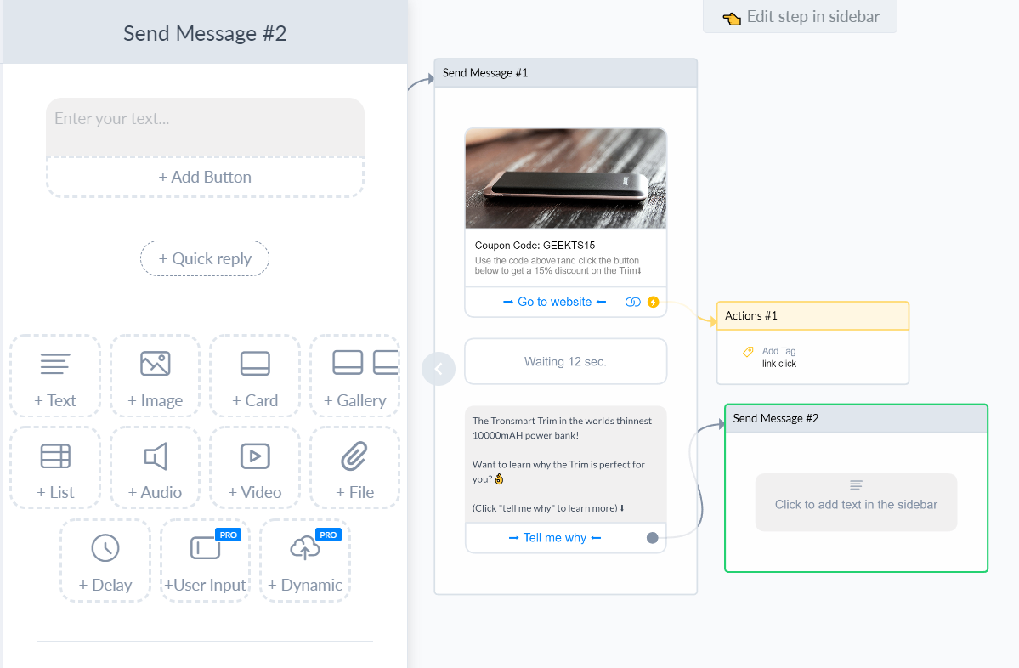
Delivery
Wait 12 sec and bring them back to the flow.
Enter new flow.
Create new flow selling the product.

Slide 25
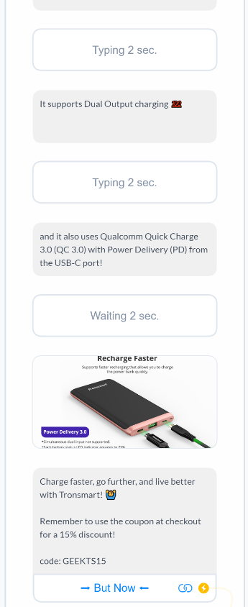
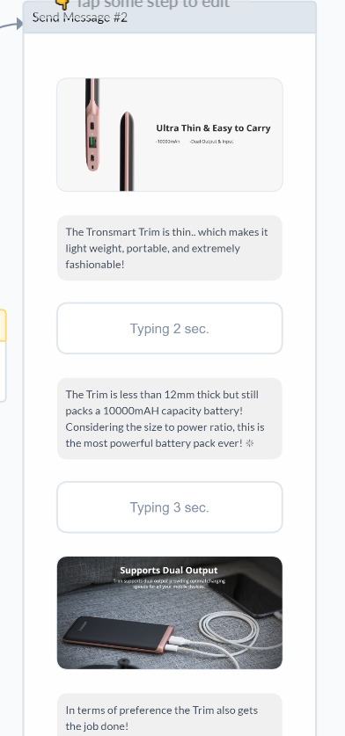
This flow will give info to sell the product in a very direct way.

Slide 26
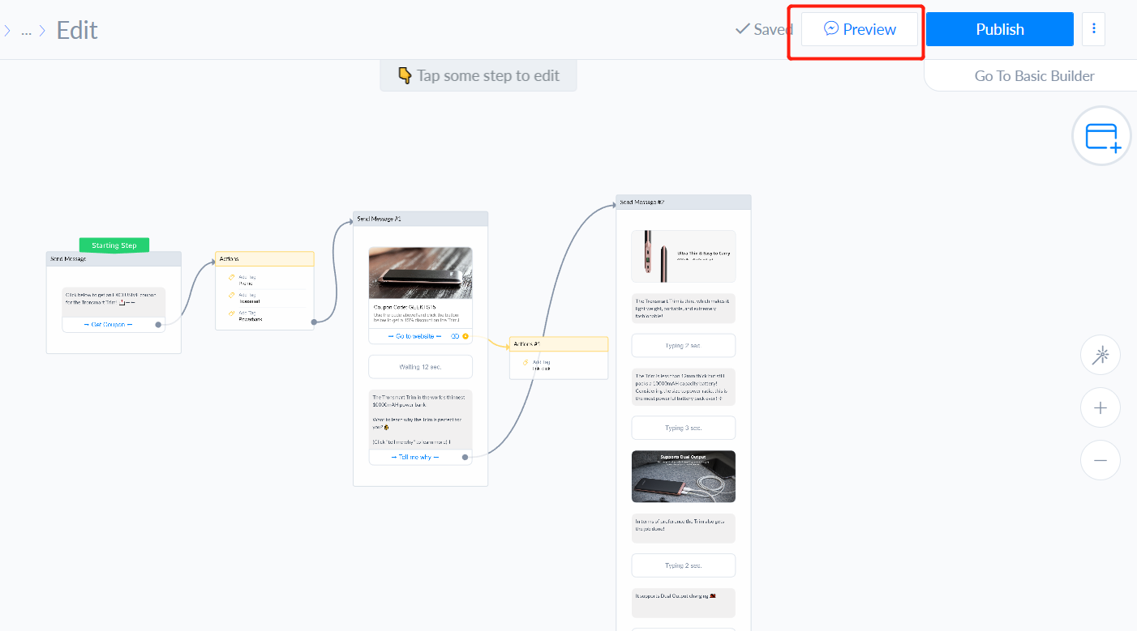
Test Your Flow
Click preview to make sure your bot is working they way you want it to.

Slide 27
Getting Users Into Your Flow
Once your flow is working you need to find ways to get users into your flow. You can send users into your flow from a Facebook post, Facebook/Instagram Ad, QR code, website button, or link.
For the flow we made we will test the Facebook comment tool and the JSON Ad.

Slide 28
JSON Ad
The JSON Ad will send a specific audience an Ad that brings them to the messenger.
In my opinion JSON Ads are the most effective form of Chatbot marketing. Make this a priority.
View the ad: https://drive.google.com/file/d/13Ia1SofcBrI6QIcvKPOyayDHIy7KJdMl/view?usp=sharing

Slide 29
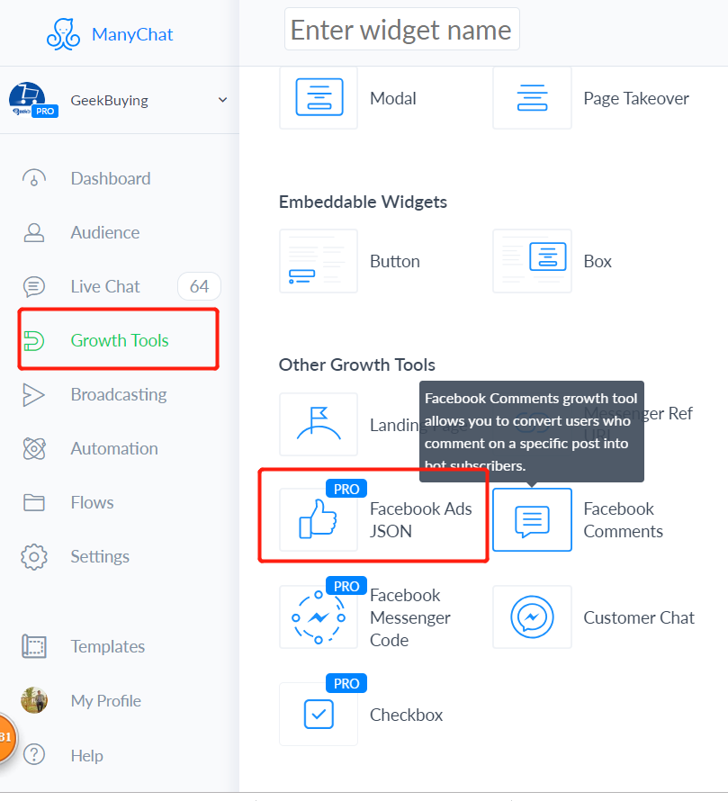
Select the Facebook Ads JSON Growth Tool.

Slide 30
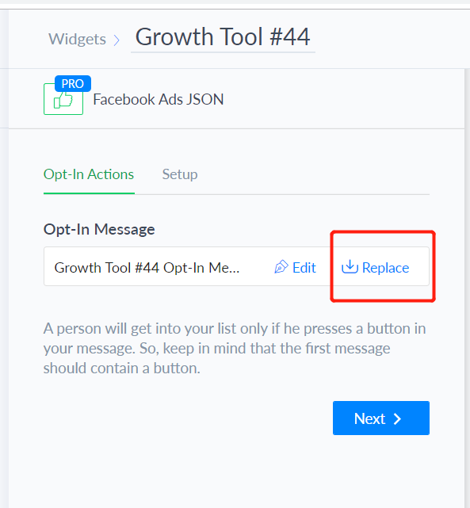
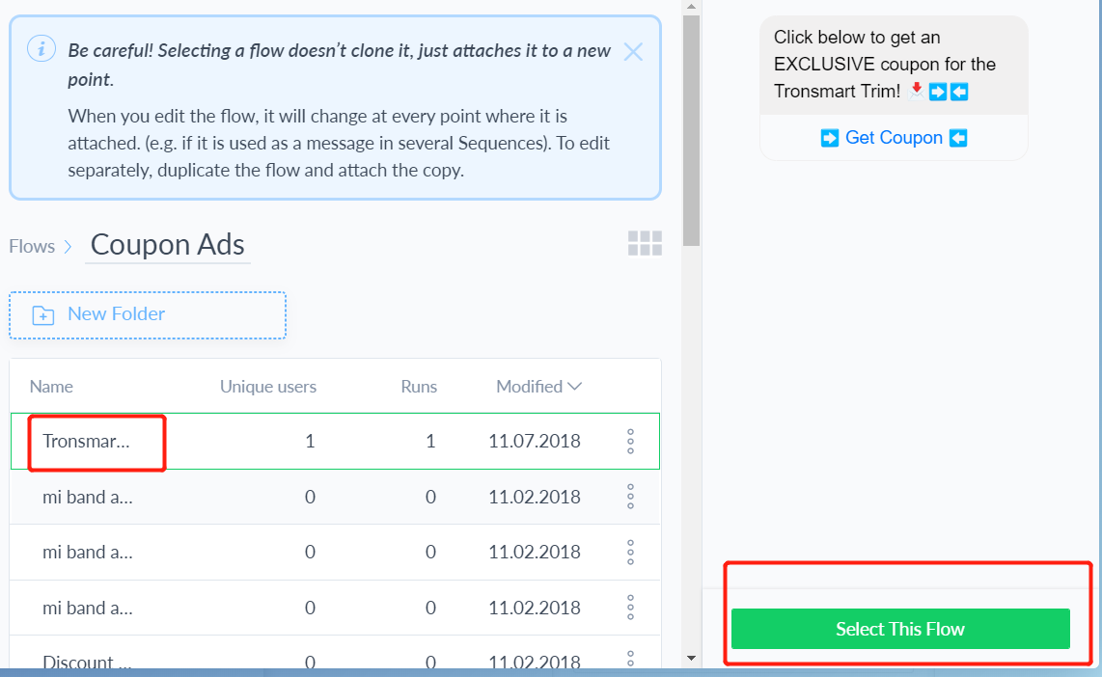

Slide 31
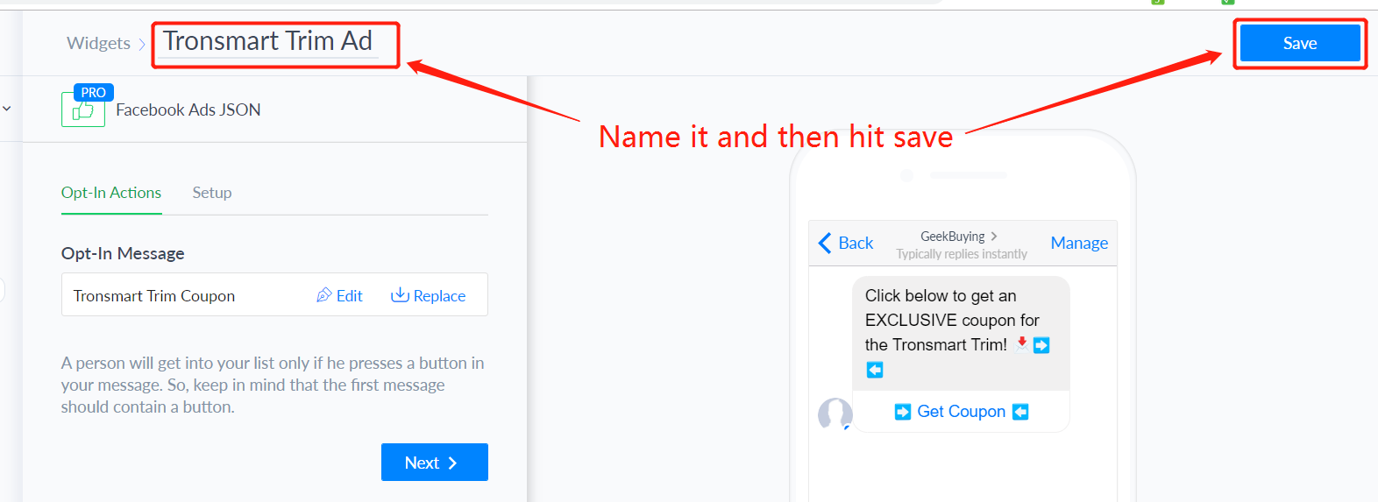
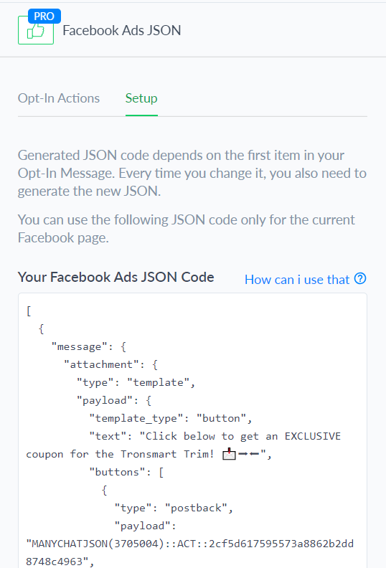
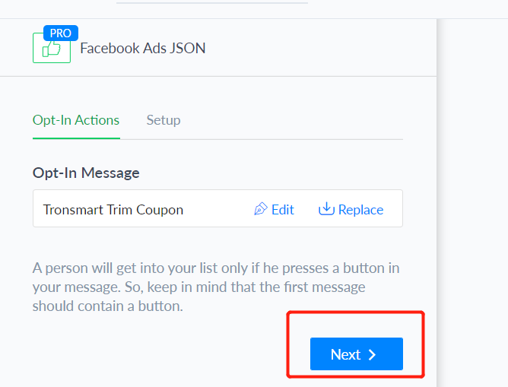

Slide 32
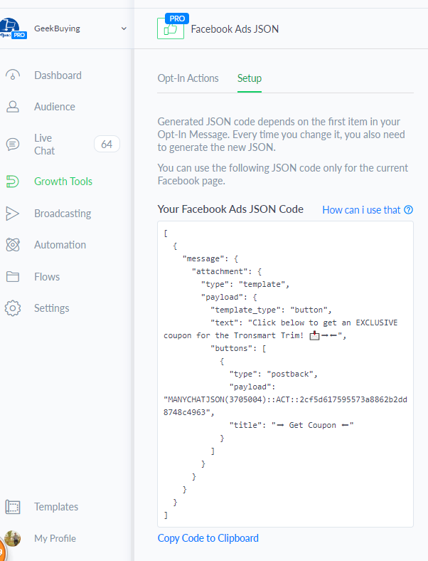
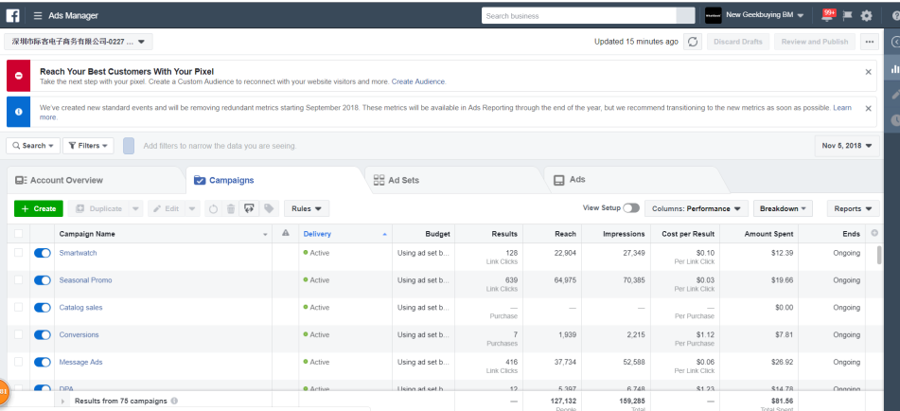
After you land on this page go to your Facebook Ads manager.

Slide 33
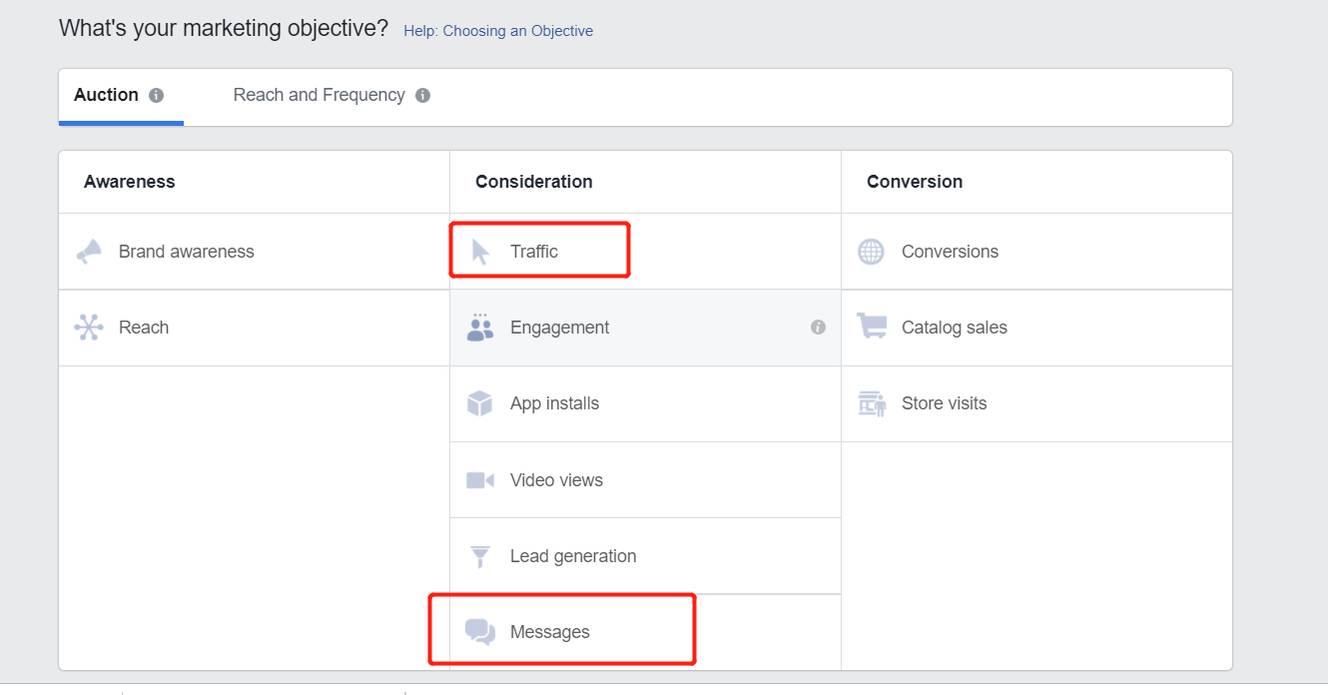
There are two objectives you can use with the JSON Ad. You can use traffic or messages.

Slide 34
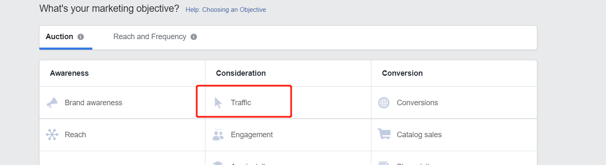
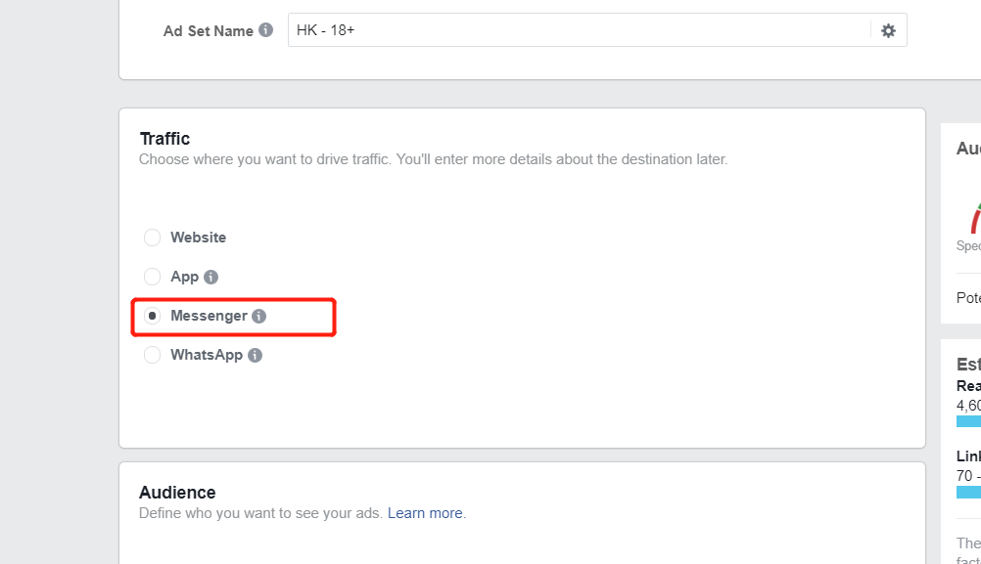
If you use traffic make sure you select “Messenger”

Slide 35
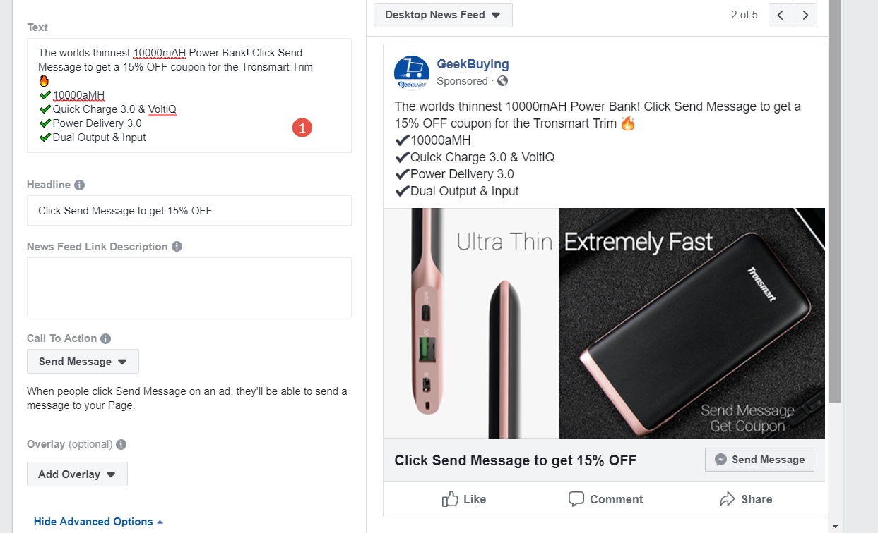
Create your Ad

Slide 36
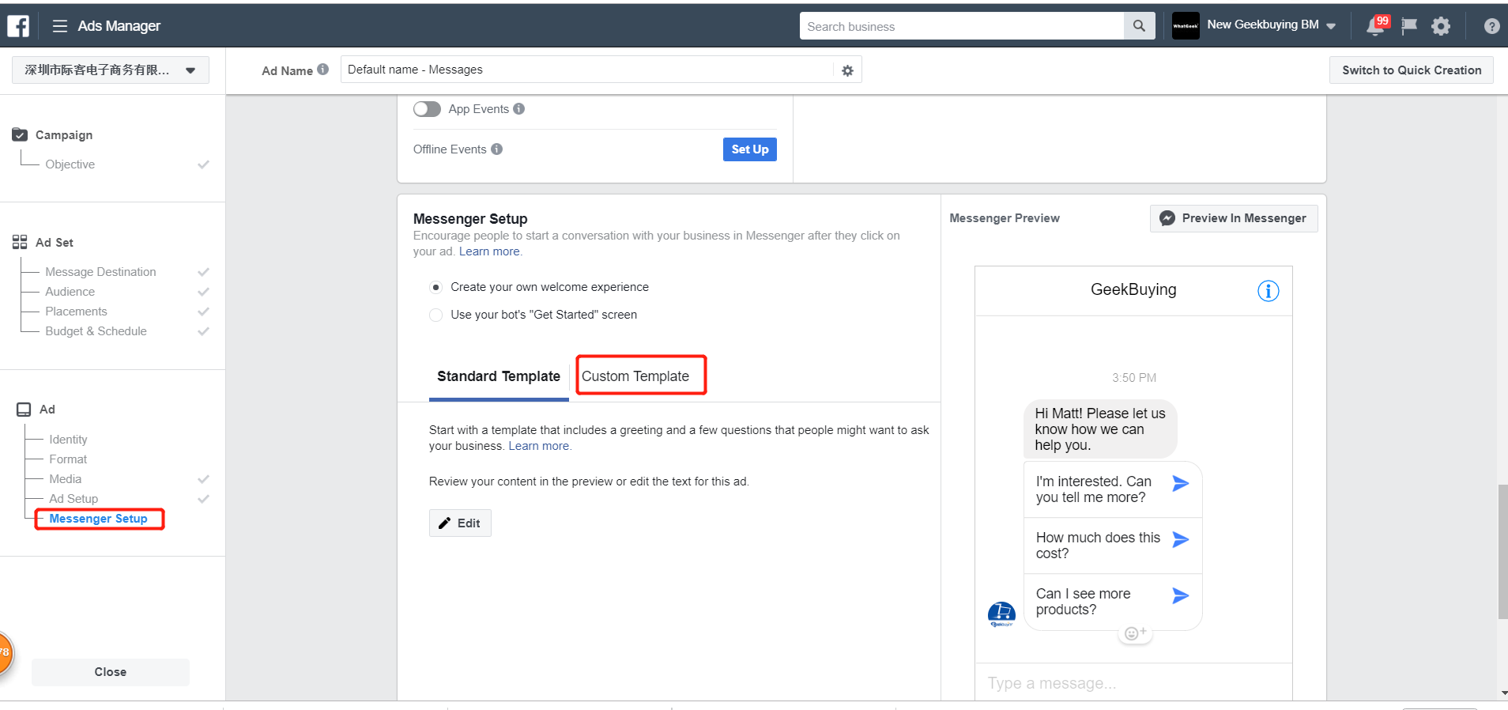

Slide 37
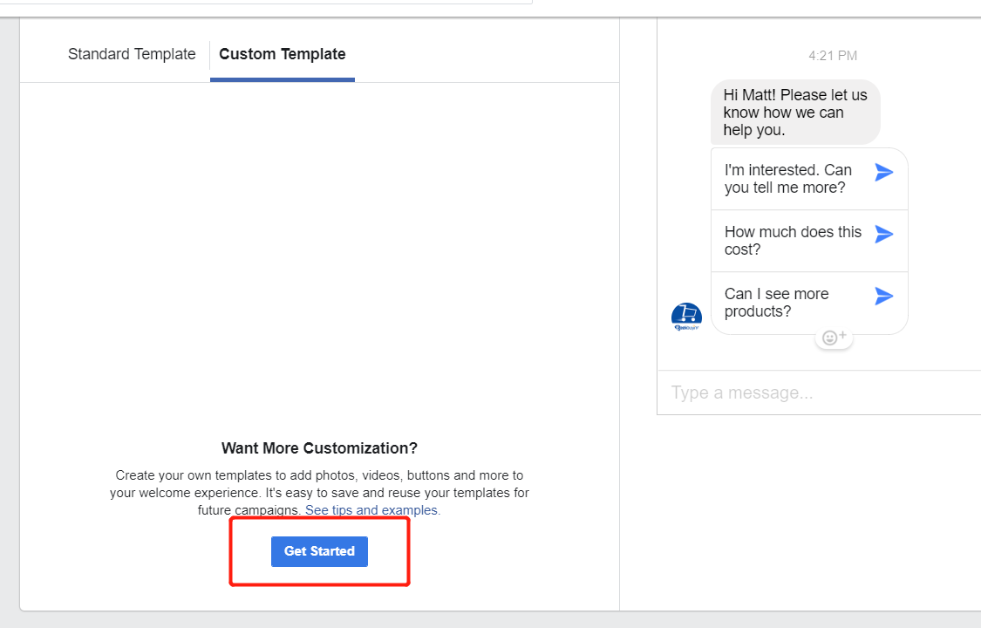

Slide 38
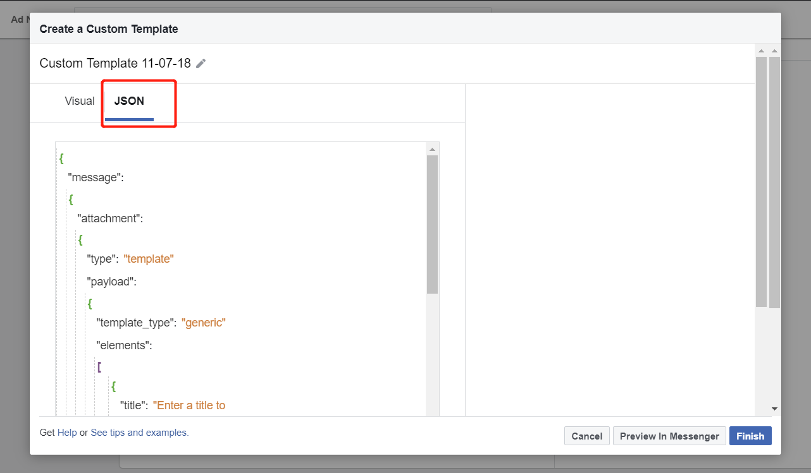

Slide 39
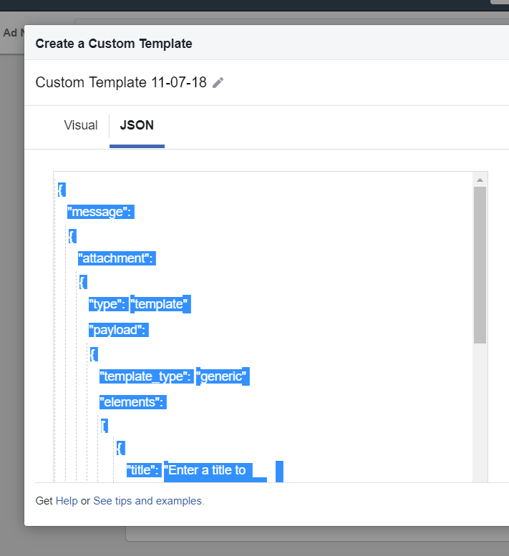
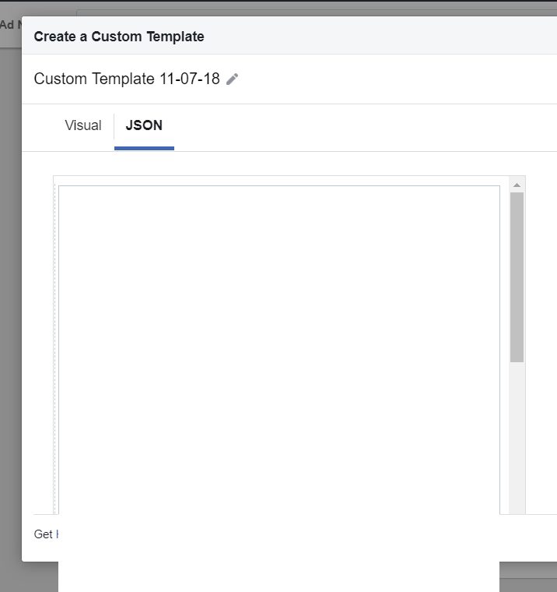
Delete this code and go back to manychat.

Slide 40


Copy the code from Manychat and paste it in JSON

Slide 41

Test your Ad here

Slide 42

Final Ad

Slide 43

Rename & Edit

Slide 44

Go to flow builder and move the starting step

Slide 45


Delete opt-in and tags

Slide 46

Add Tags here

Slide 47

Publish
We deleted the Opt-in message because the comment growth tool requires you to create a custom Opt-in message.

Slide 48
Facebook Comments Growth Tool
The Comment Growth Tool can be used on your posts to collect data from the people that engage with your brand. You can use this data to re-target and drive sales.
View the comment growth tool: https://drive.google.com/file/d/1m3Zzgm0XffaDYay4j64GoIlbDbgkGo8E/view?usp=sharing

Slide 49

Frist duplicate your flow

Slide 50

Next create a post but do not share it right away
This post tells people to comment the word “coupon” below. We want to send interested users to messenger so we must give them a path to our flow.

Slide 51

Comment Growth Tool

Slide 52

Enter Trigger Words
When users comment these words on your post they will be sent an opt-in message.

Slide 53

Set Auto-response
The auto-response tool will act as the opt-in message.

Slide 54

Set Opt-in Actions

Slide 55

Publish your post

Slide 56


Select a post

Slide 57

Save & Activate

